Slide 1

Sign2Text: Accessible Communication Platform- AI Model for specially-abled people
BIRLA INSTITUTE OF TECHNOLOGY, MESRA, JAIPUR MO-24
Pranav Patni ( BTECH/25025/21)
Namit Goyal (BTECH/25025/21)
Mentor: Dr. Archana Bhatnagar

Slide 2
Table of contents
01
02
03
04
05
06
Introduction
Tech Stack
Literature Review
Project Overview
Result
Future Scope

Slide 3
Introduction
Speech impaired people use hand signs and gestures to communicate. Normal people face difficulty in understanding their language. Hence there is a need of a system which recognizes the different signs, gestures and conveys the information to the normal people. It bridges the gap between physically challenged people and normal people

Slide 4
Bridging Communication Gaps
Exploring innovative solutions for enhancing communication between speech impaired individuals and the community through advanced image processing techniques.
Enhancing Communication for Speech Impaired Individuals
Addressing the challenges faced by speech impaired individuals through innovative image processing technology for better understanding and connection.

Slide 5
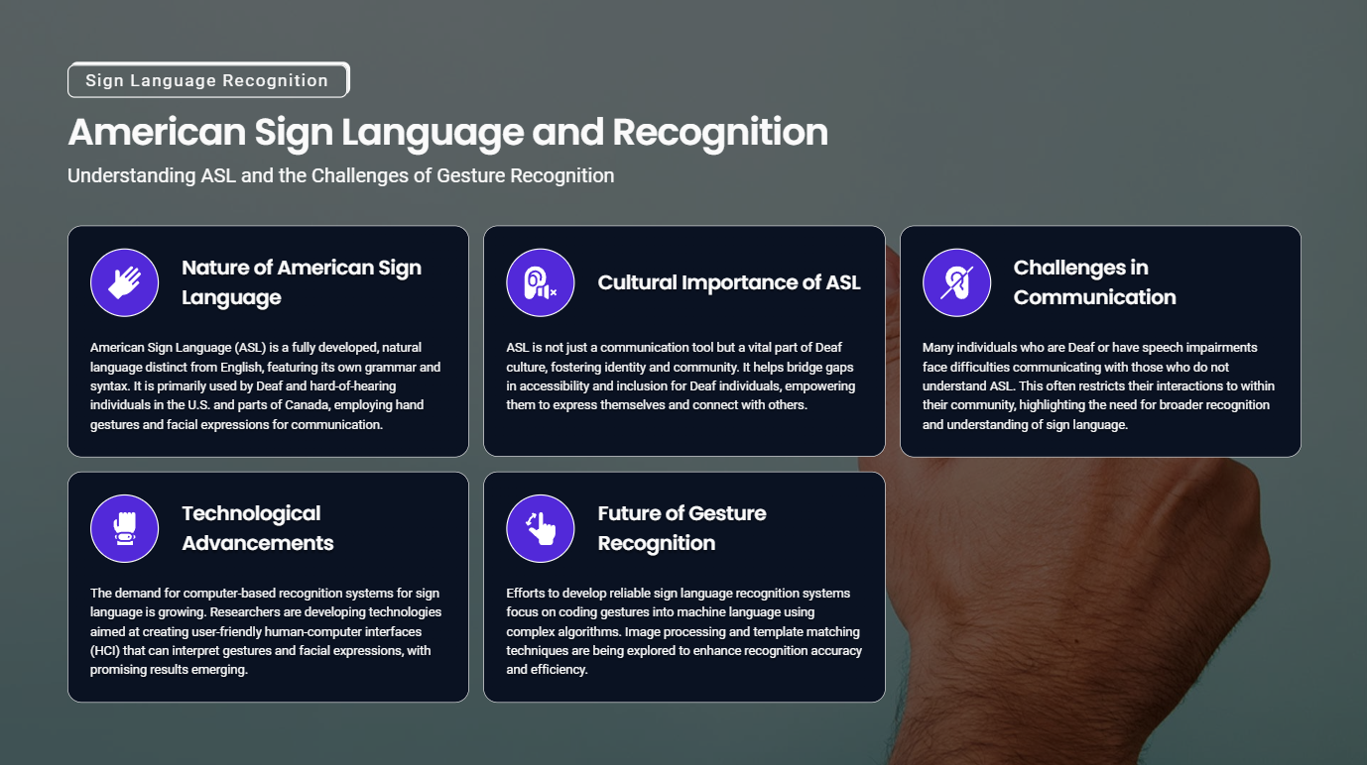
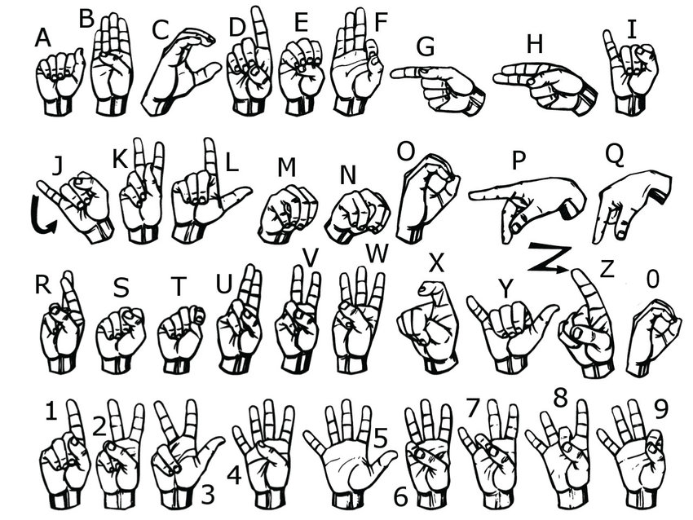

Slide 6
02
Tech Stack

Slide 7

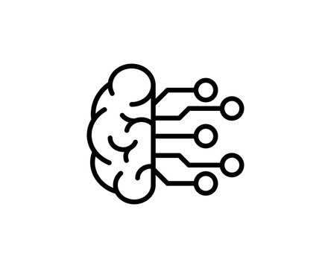
MediaPipe
MediaPipe is an open-source, cross-platform framework developed by Google for building multimodal machine learning pipelines. It is widely used for real-time perception applications like pose estimation, hand tracking, face detection, object detection, and more. MediaPipe simplifies the deployment of ML models across multiple platforms, including Android, iOS, web, and desktop, offering a uniform API and optimized performance.
Ensemble Learning
Ensemble learning is a machine learning paradigm where multiple models, often referred to as "weak learners" or "base models," are combined to solve a particular computational problem. The central idea is to leverage the collective decision-making of multiple models to achieve better predictive performance than any individual model alone. Ensemble methods are widely used to enhance the accuracy, robustness, and generalization of machine learning algorithms.

Slide 8

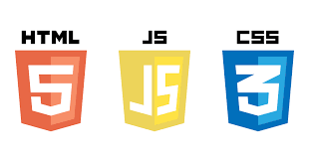
Flask
Flask is a lightweight and flexible web framework for Python that allows developers to build web applications quickly and efficiently. Known as a "micro-framework," Flask provides the essential tools needed for web development while maintaining simplicity and extensibility. Flask’s modularity makes it suitable for projects ranging from simple websites to complex platforms, allowing developers to add functionality as needed through plugins or extensions.
Frontend Development
Frontend development focuses on building the visual and interactive components of a website or web application that users interact with directly. It involves creating a responsive and engaging user interface (UI) using technologies like HTML for structure, CSS for styling, and JavaScript for interactivity. Frontend developers also use frameworks and libraries, such as Bootstrap or React, to enhance development speed and maintain design consistency. The ultimate goal is to ensure a seamless and visually appealing user experience across various devices and browsers.

Slide 9
03
Literature Review

Slide 10
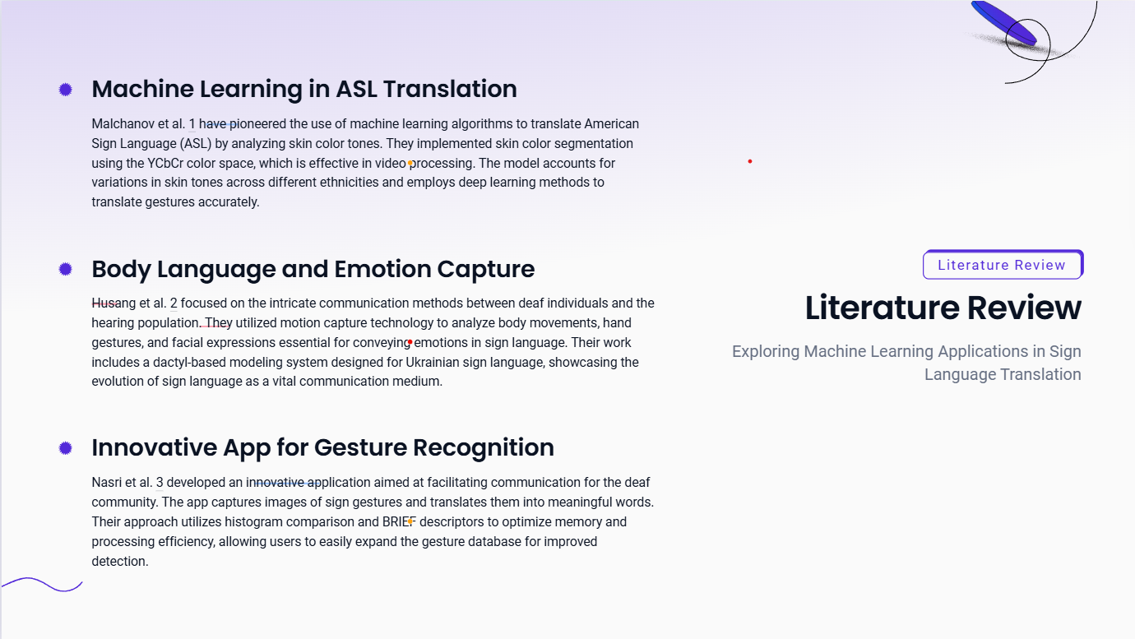

Slide 11
04
Project Overview

Slide 12
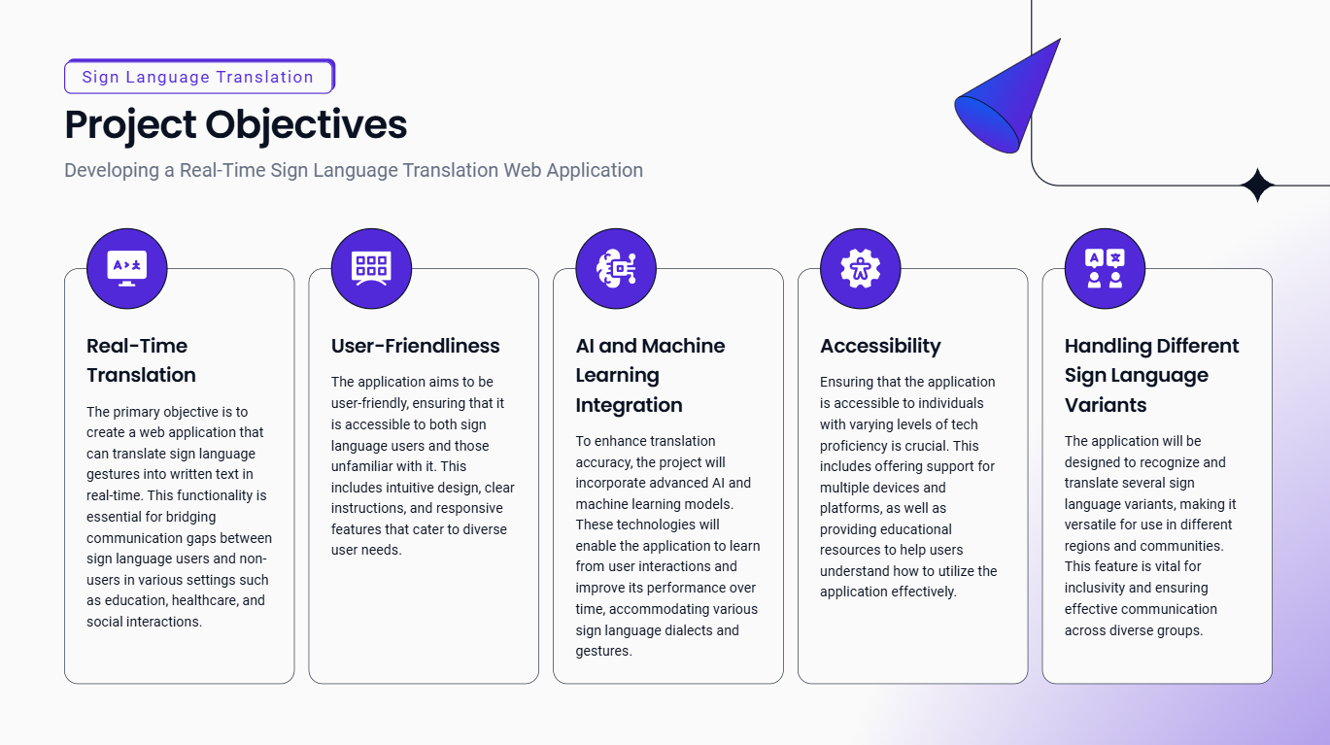

Slide 13
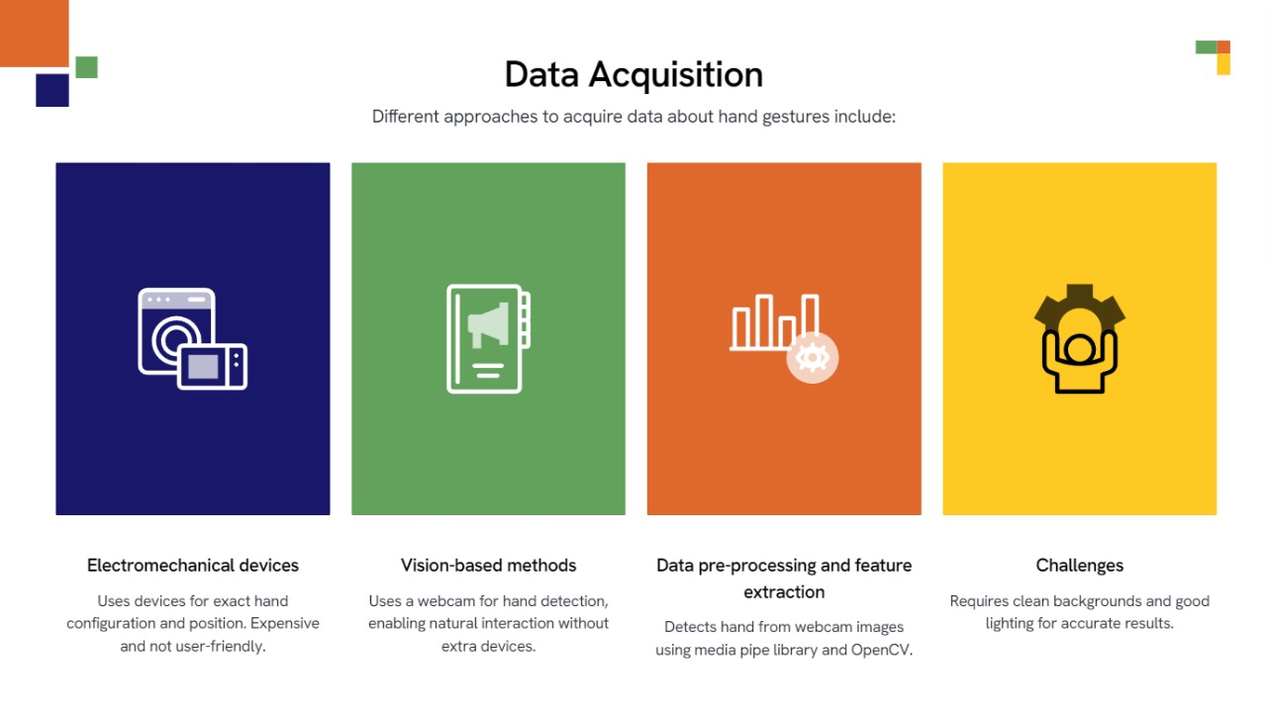
Notes:
In this approach for hand detection, firstly we detect hand from image that is acquired by webcam and for detecting a hand we used media pipe library which is used for image processing. So, after finding the hand from image we get the region of interest (Roi) then we cropped that image and convert the image to gray image using OpenCV library after we applied the gaussian blur .The filter can be easily applied using open computer vision library also known as OpenCV. Then we converted the gray image to binary image using threshold and Adaptive threshold methods.
We have collected images of different signs of different angles for sign letter A to Z.
In this method there are many loop holes like your hand must be ahead of clean soft background and that is in proper lightning condition then only this method will give good accurate results but in real world we dont get good background everywhere and we don’t get good lightning conditions too.

Slide 14
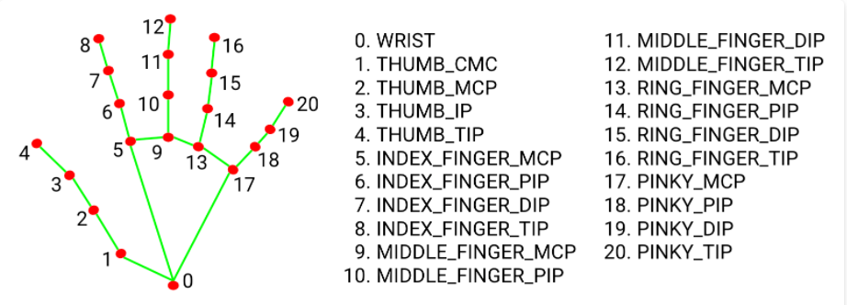
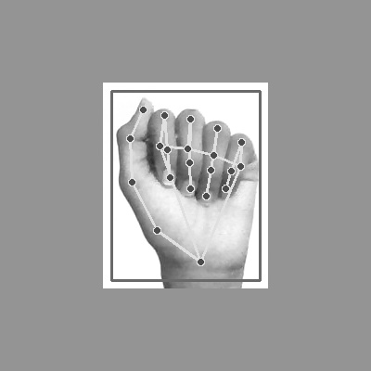
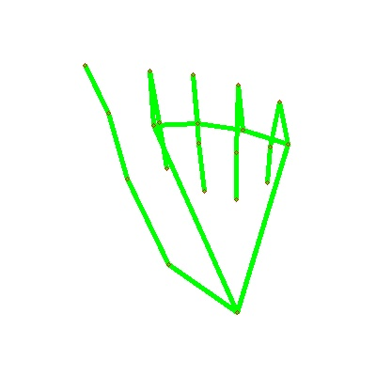
Mediapipe Landmark System
Notes:
So to overcome this situation we try different approaches then we reached at one interesting solution in which firstly we detect hand from frame using mediapipe and get the hand landmarks of hand present in that image then we draw and connect those landmarks in simple white image.

Slide 15
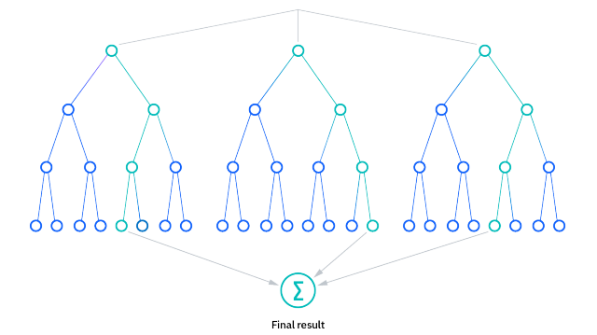
What is random forest?
What it does: Random Forest is a machine learning algorithm that is used for classification and regression tasks. Random forest algorithms have three main hyperparameters, which need to be set before training. These include node size, the number of trees, and the number of features sampled. From there, the random forest classifier can be used to solve for regression or classification problems.
In the context of sign language recognition, it helps in classifying gestures into categories (like 'Hello', 'Thank you', etc.).
How it works: Random Forest works by creating multiple decision trees during training. When a new input (gesture data) is given, it passes through all the trees, and the most common prediction among them is chosen as the final result. This method helps in improving accuracy and handling variations in gestures.
Why it's important: Random Forest can handle complex sign language gestures by breaking down the recognition process into simpler steps, ensuring that the system can classify gestures accurately, even in challenging conditions (like different lighting or hand positions).
Together, MediaPipe handles the real-time tracking of gestures, while Random Forest is responsible for accurately classifying those gestures into meaningful translations (text).

Slide 16
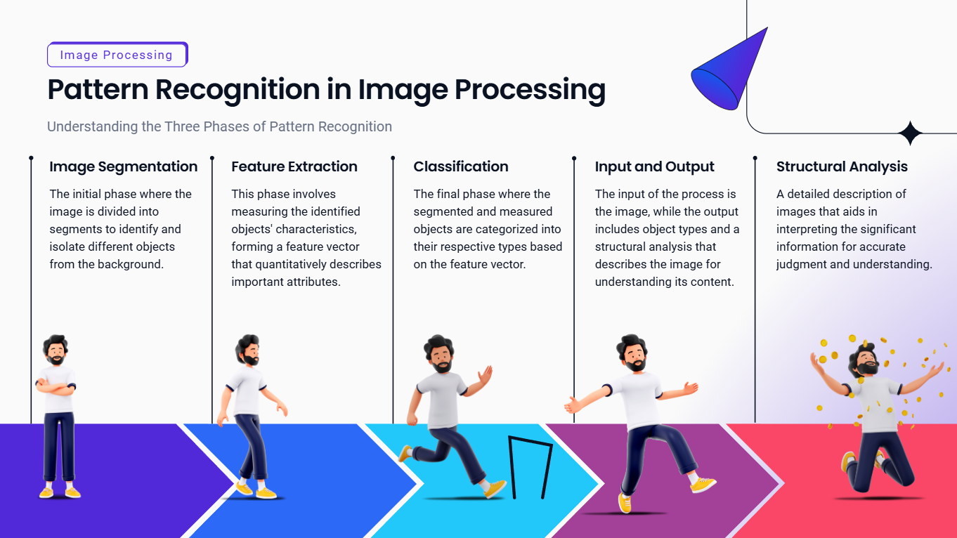

Slide 17
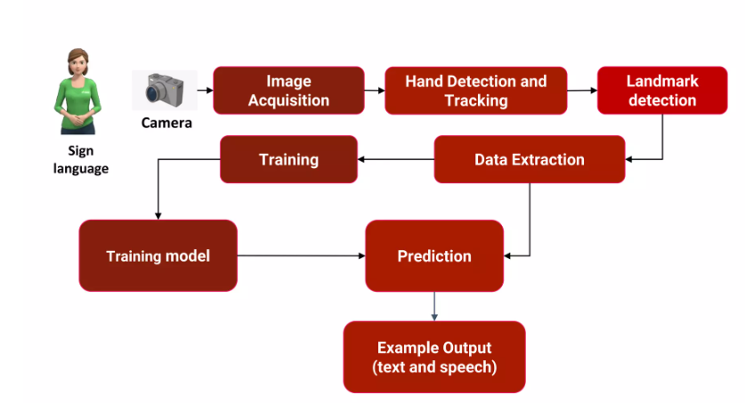
Project Data Flow : How the system works

Slide 18
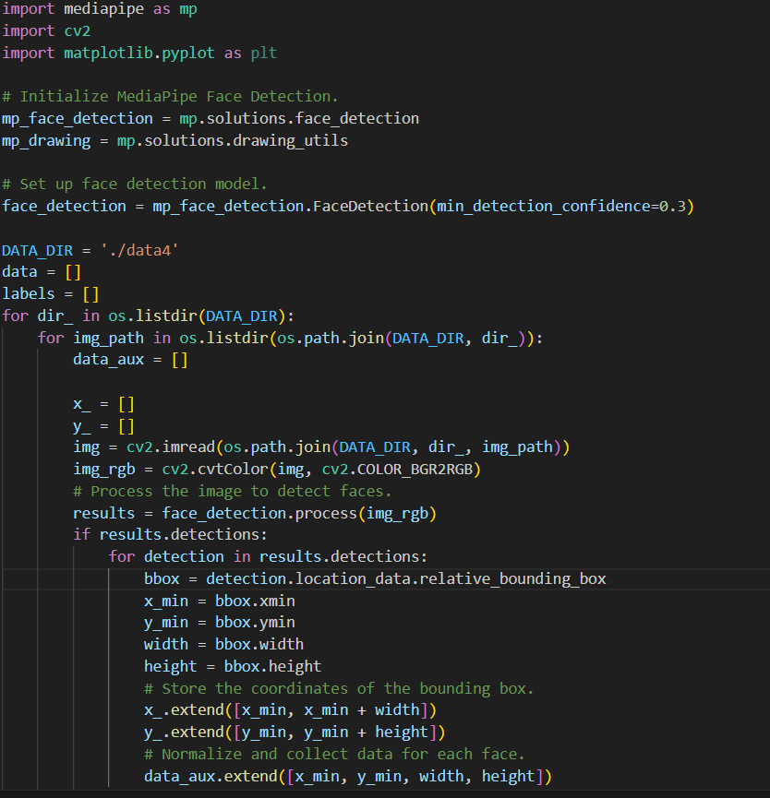
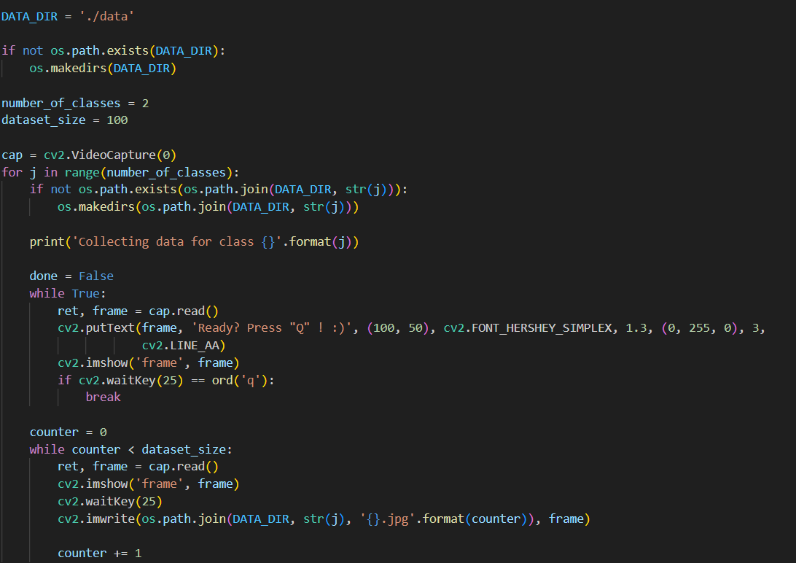
STEP-2: Extracted the features (X,Y Coordinates) from the images from the help of media pipe and then dump (save) those features extracted in pickle file
DATA SET IMPLEMENTATION
STEP-1: Collected images file- 100 images for each letter to train model

Slide 19
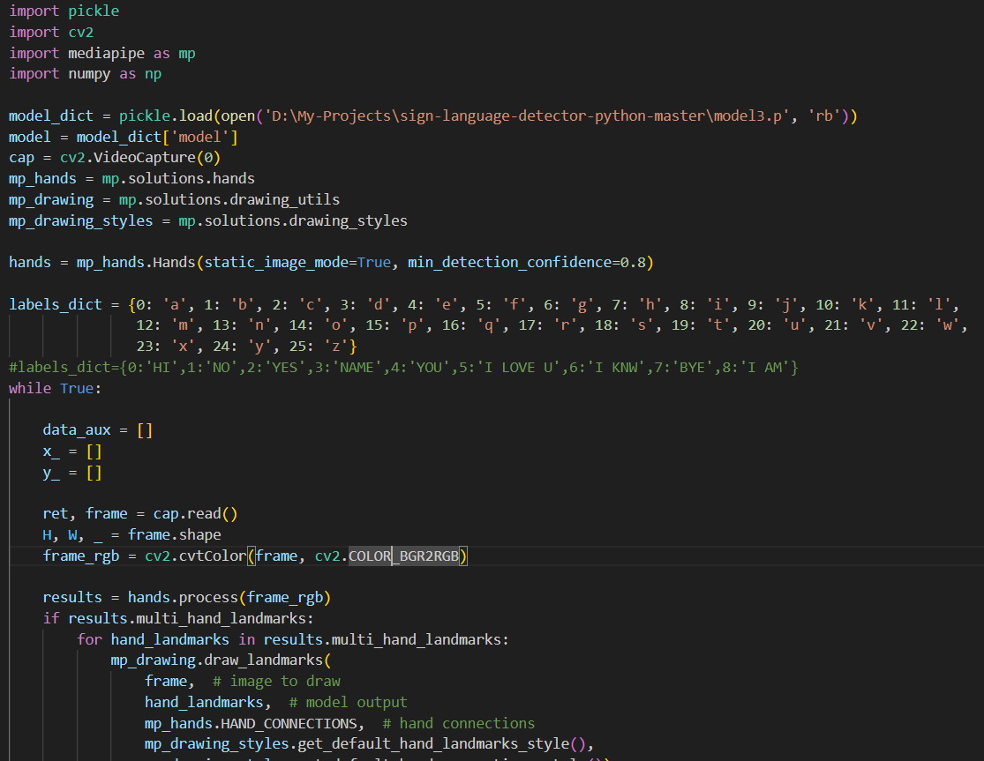
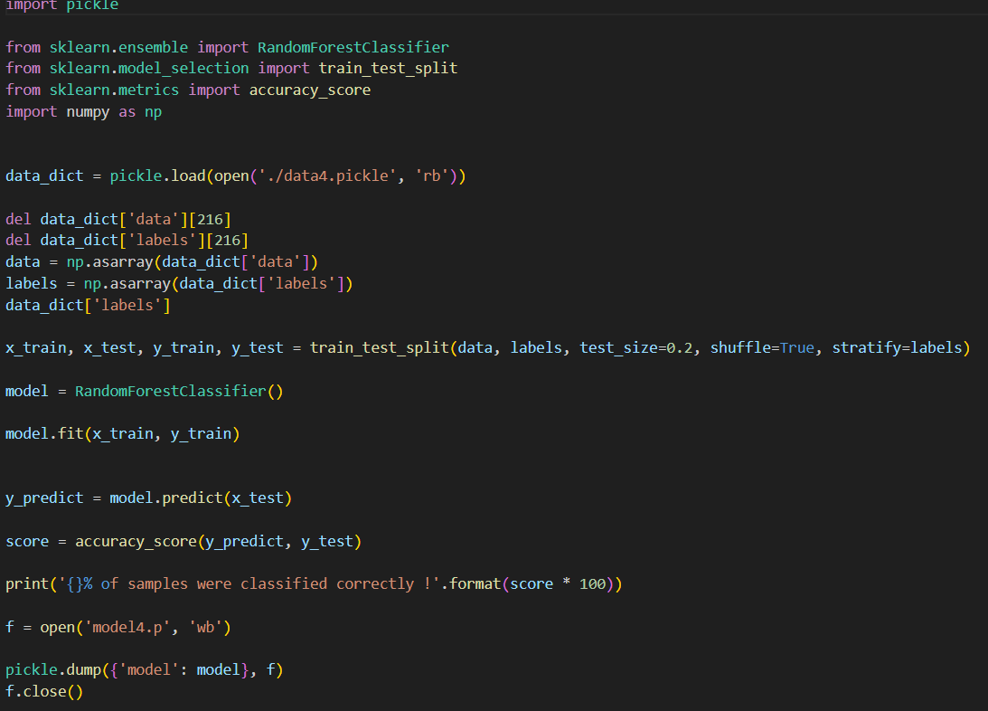
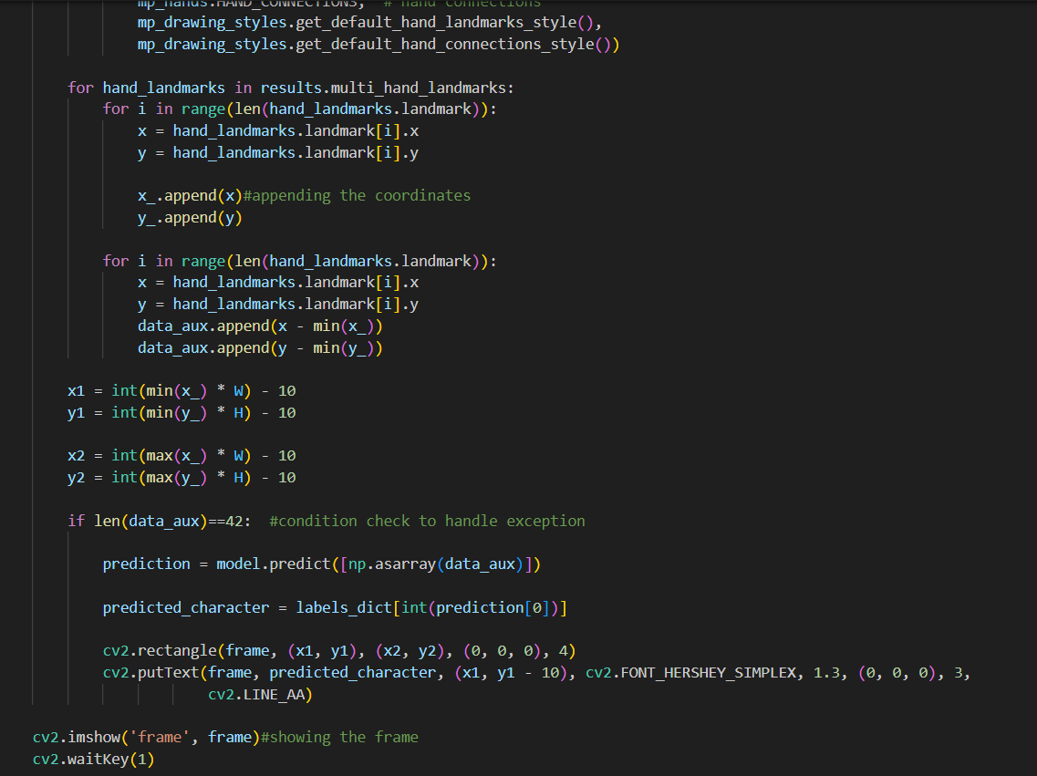
STEP-3 : Now opening that pickle and using the features to train the model
STEP-4: Now after training , testing our model using different images

Slide 20
05
Result

Slide 21
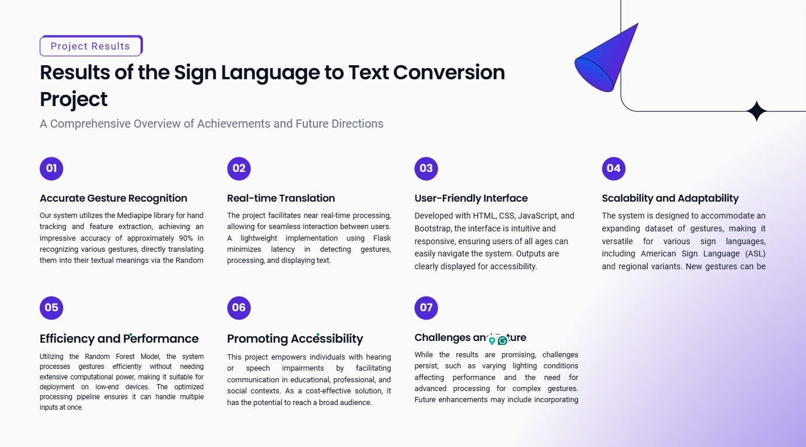

Slide 22
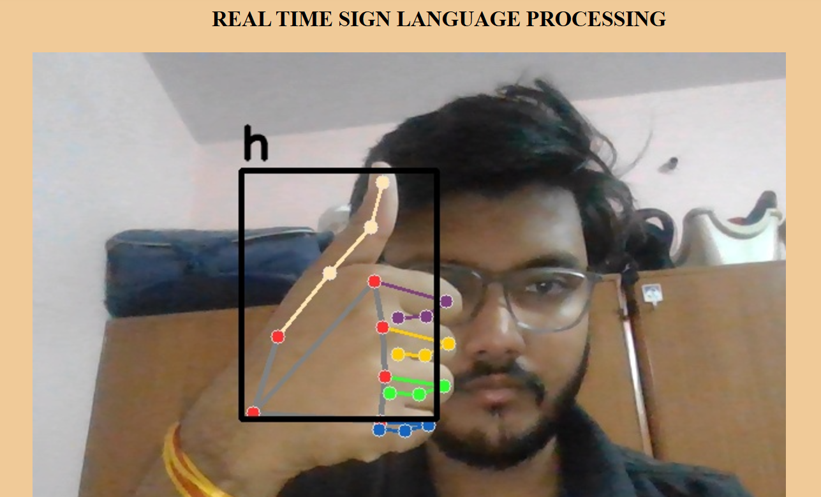
Real time working model

Slide 23
06
Future Scope

Slide 24
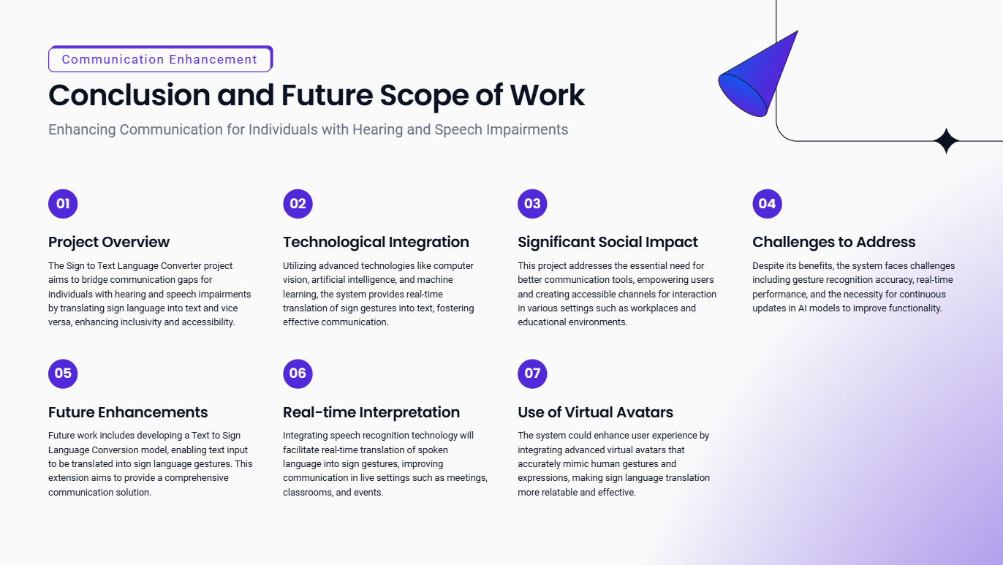

Slide 25
References
American Sign Language (ASL) Dictionary: A comprehensive source for the visual representation of ASL gestures and their corresponding meanings.
Machine Learning Techniques for Gesture Recognition: Research papers and articles focusing on convolutional neural networks (CNNs) and recurrent neural networks (RNNs) for real-time gesture recognition.
Dhruv, A., & Bharti, S. (2021). Real-Time Sign Language Converter for Mute and Deaf People. 2021 International Conference on Artificial Intelligence and Machine Vision (AIMV),1-6. https://doi.org/10.1109/aimv53313.2021.9670928.
Vu, H., Hoang, T., Tran, C., & Pham, C. (2023). Sign Language Recognition with Self-Learning Fusion Model. IEEE Sensors Journal, 23, 27828-27840. https://doi.org/10.1109/JSEN.2023.3314728.

Slide 26
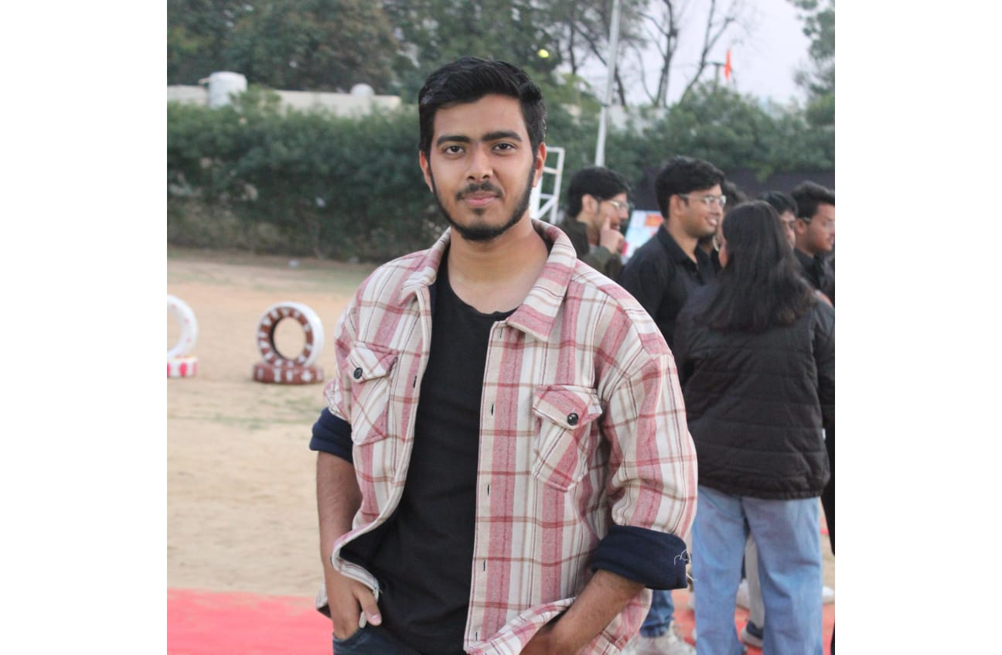
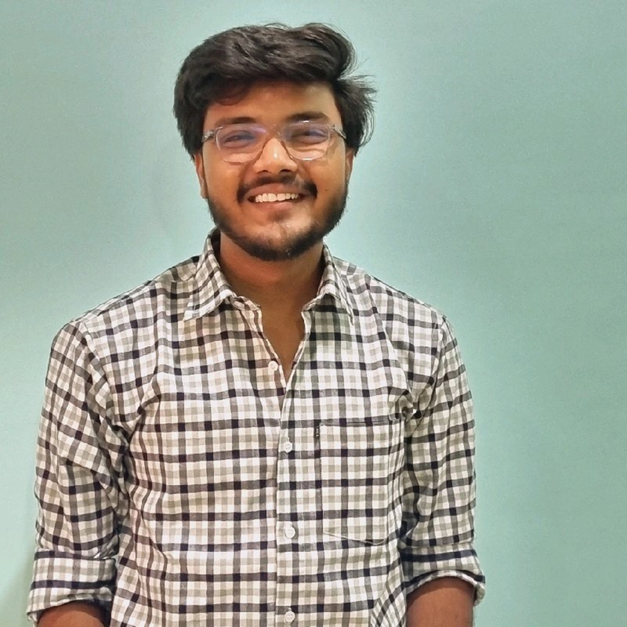
OUR TEAM
Thank You
Pranav Patni
Namit Goyal
BTECH/25002/21
BTECH/25025/21
Source Code: https://github.com/Pranav27092003/AIModel

